Slide 1
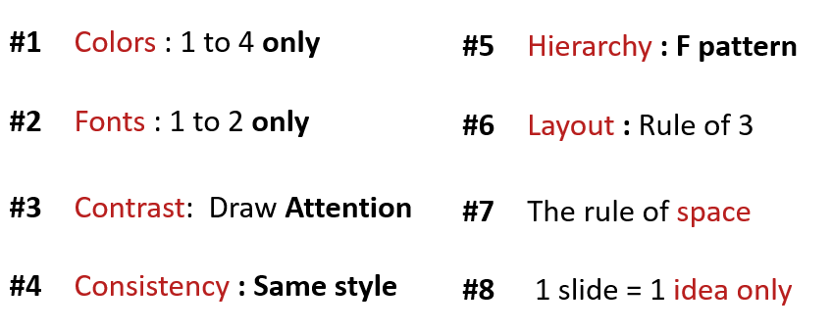
ACTIVITY 2
Analyze the problems on the slides
What is not useful ?
Which rule is not valid?
Improve the slides to fix the problem

Slide 2
Quiz-app G-7
MSK
AGENDA
1. THE SELLER
KEA NHOR
2. THE TECH
SOPHAL SARARN
3. THE MANAGER
MENG MAO

Slide 3

Quiz-app G-7
The Manager
MSK
3 What your team need to improve?
Improve communication & time management
Improve researching skills & responsibility
Improve discussing & solidarity

Slide 4
Analyze the problems on the slides
Slide1
Slide problem in the color .
No grup.
Fonts zixe unequal.
Don’t the pichure know.
Improve the slides to fix the problem
Put pichure no write letters​a lot.
The use color.
The use fonts.
Slide2
The Color
Heve the pichure Emake.
Clear information.
The contrast color.
Improve the slides to fix the problem
Use the big pichure.
Do not use too many fashions.

